Slide 1
Activities
Introduction to Activities | Android Developers

Slide 2
Android Components
Activities: They dictate the UI and handle the user interaction to the smart phone (device) screen.
Services: They handle background processing associated with an application
Broadcast Receivers: They handle communication between Android OS and applications.
Content Providers: They handle data and database management issues.
Application Fundamentals | Android Developers

Slide 3
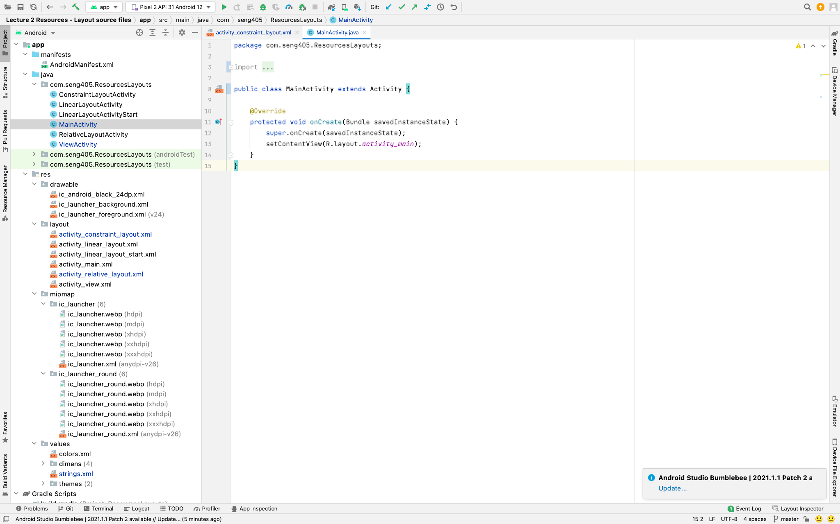
Activities
Basic component used in Android applications
An activity is an independent and reusable component that interacts with the user by providing UI-relevant resources. All Android applications must have at least one activity to enter the app and interact with users.

Slide 4
Activity - Layout
An Activity is an application component that provides a screen with which users can interact in order to do something.
Activities provide a framework for the Java code that allows the user to interact with the layouts defined in the resources.

Slide 5
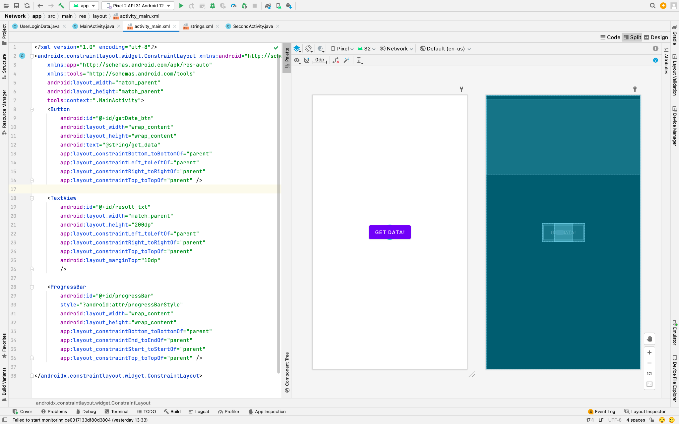
Activity - Layout

Slide 6
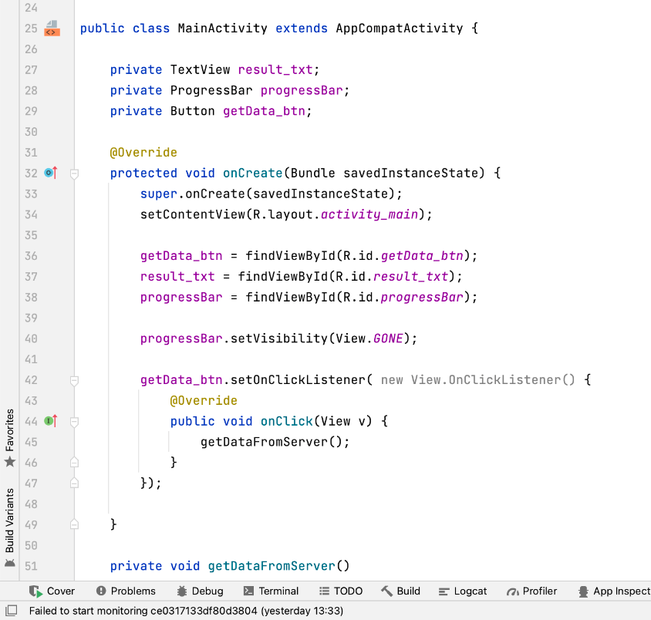
Activity - Layout
findViewById

Slide 7
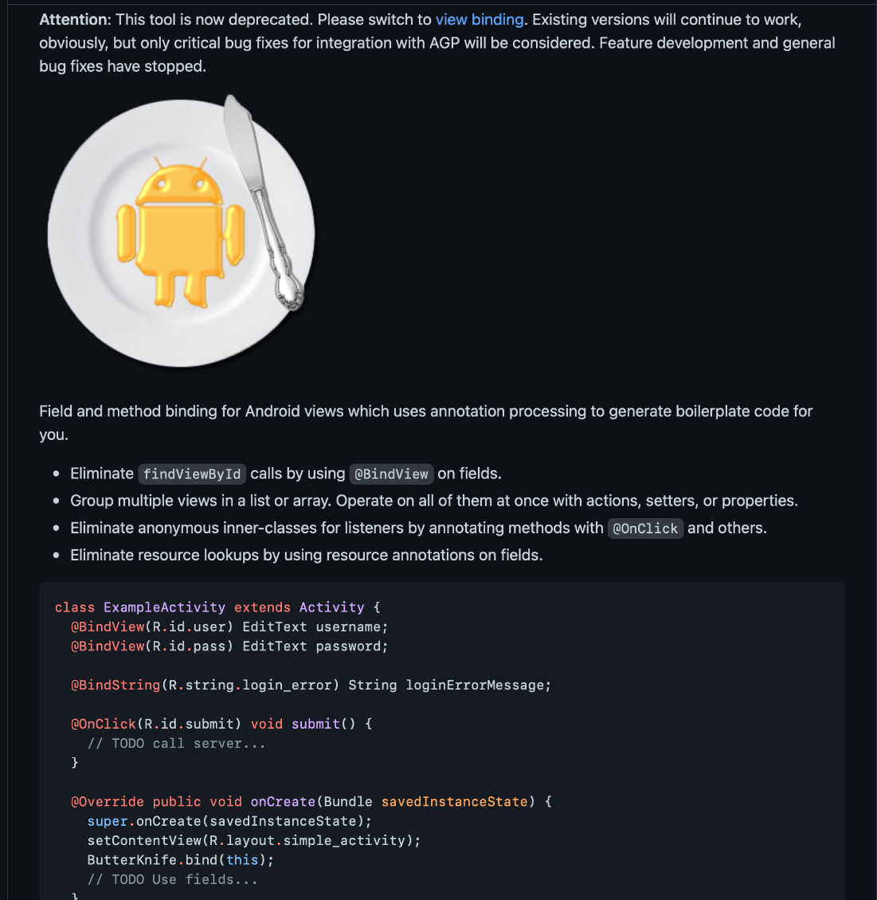
Butter Knife
GitHub - JakeWharton/butterknife: Bind Android views and callbacks to fields and methods.

Slide 8

View Binding (Part of Android Jetpack)
View Binding | Android Developers

Slide 9
Activity Lifecycle
Activity does not have a constructor
Activities are created and managed by the Android operating system when the app is launched.
Activities do have an very well-defined lifecycle
A series of events that occur during usage
The Activity Lifecycle | Android Developers

Slide 10
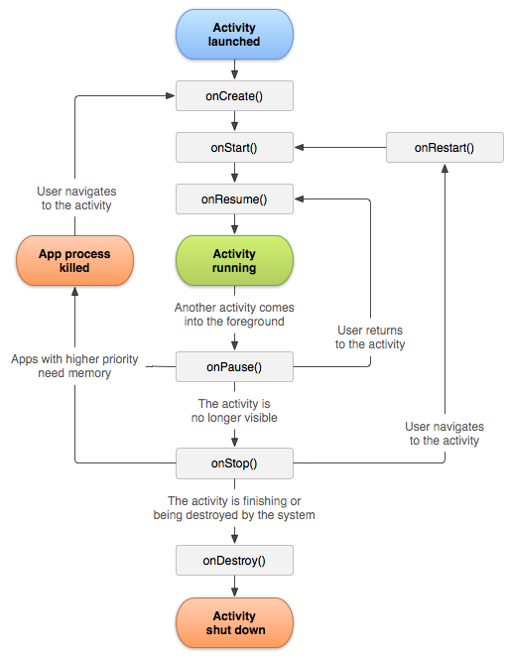
Activity Lifecycle
There are 7 “events” that occur in the Activity Lifecycle, which are designated by the callback function that they execute:
onCreate
onStart
onResume
onPause
onStop
onRestart
onDestroy

Slide 11
Activity Launched - Running
onCreate(): called when the Activity is first created/instantiated. This is where you initialize the UI (e.g., specify which layout to use), and otherwise do the kinds of work that might go in a constructor.
onStart(): called just before the Activity becomes visible to the user. The difference between onStart() and onCreate() is that onStart() can be called more than once (e.g., if you leave the Activity, thereby hiding it, and come back later to make it visible again).
onResume(): called just before user interaction starts, indicating that the Activity is ready to be used! This is a little bit like when that Activity “has focus”. While onStart() is called when the Activity becomes visible, onResume() is called when it is ready for interaction. It is possible for an Activity to be visible but not interactive, such as if there is a modal pop-up in front of it (partially hiding it). “onFocus” would have been a better name for this callback.

Slide 12
Activity Running - Shut Down
onPause(): called when the system is about to start another Activity (so this one is about to lose focus). This is the “mirror” of onResume(). When paused, the activity stays visible! This callback is usually used to quickly and temporarily store unsaved changes (like saving an email draft in memory) or stop animations or video playback. The Activity may be being closed (and so is on its way out), but could just be losing focus.
onStop(): called when the Activity is no longer visible. (e.g., another Activity took over, but also possibly because the current Activity has been destroyed). This callback is a mirror of onStart(). This callback is where you should persist any state information (e.g., saving the user’s document or game state). It is intended to do more complex “saving” work than onPause().
onDestroy(): called when the Activity is about to be closed. This can happen because the user ended the application, or (and this is important!) because the OS is trying to save memory and so kills the Activity on its own. The onDestroy() callback can do final app cleanup, but its is considered better practice to have such functionality in onPause() or onStop(), since they are more reliably executed. Activities are also destroyed (and recreated) when the device’s configuration changes—such as if you rotate the phone.

Slide 13
onRestart
onRestart(): called when the Activity is coming back from a “stopped” state. This event allows you to run distinct code when the App is being “restarted”, rather than created for the first time. It is the least commonly used lifecycle callback.

Slide 14
Activity Lifecycle
There are 7 “events” that occur in the Activity Lifecycle, which are designated by the callback function that they execute:
onCreate
onStart
onResume
onPause
onStop
onRestart
onDestroy

Slide 15
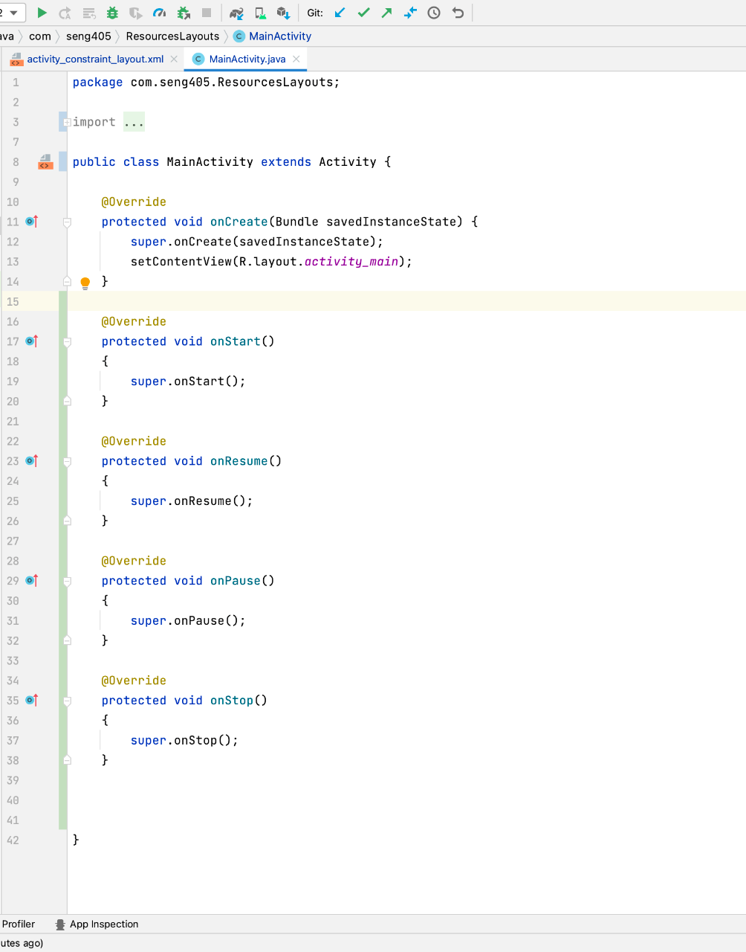
Overriding the Callback Methods
When you create an new Empty MainActivity, the onCreate() callback has already been overridden for you, since that’s where the layout is specified.
Always call up the inheritance chain

Slide 16
Bundle
A Bundle is an object that stores key-value pairs, like a super-simple HashMap (or an Object in JavaScript, or dictionary in Python). Bundles can only hold basic types (numbers, Strings) and so are used for temporarily “bundling” small amounts of information.
onCreate callback takes a Bundle as a parameter.
Serializable, Parcelable

Slide 17
Saving and Restoring Activity State
Bundle is used to store information about the Activity’s current state, so that if the Activity is destroyed and recreated (e.g., when the phone is rotated), it can restored in the same state and the user won’t lose any data.
For example, the Bundle can store state information for View elements, such as what text a user has typed into an EditText. That way when the user rotates their phone, they won’t lose the form input they’ve entered! If a View has been given an android:id attribute, then that id is used to automatically save the state of that View, with no further effort needed on your own.
You can also add your own custom information to the Bundle by overriding the Activity’s onSaveInstanceState() callback (use the one for AppCompactActivity that only takes one parameter). It takes as a parameter the Bundle that is being constructed with the saved data: you can add more information to this Bundle using an appropriate put() method (similar to the method used for Maps, but type-sensitive)

Slide 18
Saving and Restoring Activity State
Note that you should always declare Bundle keys as CONSTANTS to help with readability/modifiability and to catch typos. You can access this saved Bundle from the Activity’s onCreate() method when the Activity is recreated. Note that if the Activity is being created for the first time, then the Bundle will be null—checking for a null value is thus a good way to check if the Activity is being recreated or not private static final String MSG_KEY = "message_key"; @Override protected void onSaveInstanceState(Bundle outState) { outState.putString(MSG_KEY, "Hello World"); super.onSaveInstanceState(outState); } protected void onCreate(Bundle savedInstanceState) { super.onCreate(savedInstanceState); if(savedInstanceState != null){ //Activity has been recreated String msg = savedInstanceState.getString(MSG_KEY); } else { //Activity created for first time } }

Slide 19
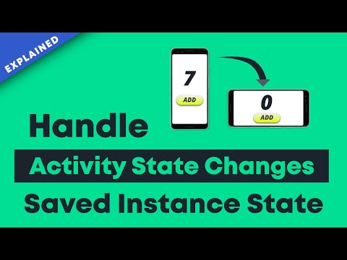

Slide 20
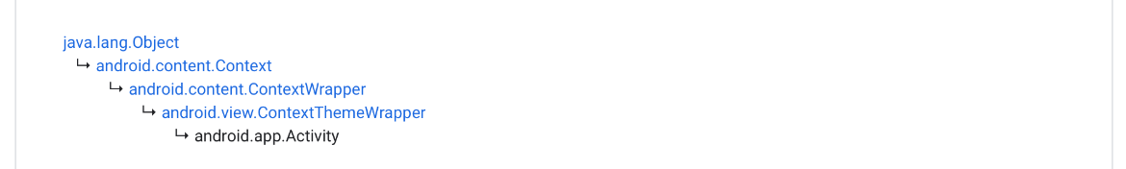
Context
If you look at the documentation for the Activity class, you’ll notice that it is itself a subclass of something called a Context. Context is an abstract class that acts as a reference for information about the current running environment: it represents environmental data (information like “What OS is running? Is there a keyboard plugged in?”).
You can almost think of the Context as representing the “Application”, though it’s broader than that (Application is actually a subclass of Context!)
The Context is used to do “application-level” actions: mostly working with resources (accessing and loading them), but also communicating between Activities. Effectively, it lets us refer to the state in which we are running: the “context” for our code (e.g., “where is this occurring?”). It’s a kind of reflection or meta-programming, in a way. For example, the getResources() method discussed in the Resources And Layouts is a method of the Context class, because we need to have some way of saying which set of resources to load!
There are a couple of different kinds of Contexts we might wish to refer to:
The Application context (e.g., an Application object) references the state of the entire application. It’s basically the Java object that is built out of the <application> element in the Manifest (and so contains that level of information).
The Activity context (e.g., an Activity object) that references the state of that Activity. Again, this roughly corresponds to the Java objects created out of the <activity> elements from the Manifest.
Each of these Context objects exist for the life of its respective component: that is, an Activity Context is available as long as the Activity exists (disappearing after onDestroy()), whereas Application Contexts survive as long as the application does. We’ll almost always use the Activity context, as it’s safer and less likely to cause memory leaks.
Notes:
Inside an Activity object (e.g., in a lifecycle callback function), you can refer to the current Activity using this. And since Activity is a Context, you can also use this to refer to the current Activity context. You’ll often see Context methods—like getResources()—called as undecorated methods (without an explicit this).

Slide 21
Difference between application context and activity context
Application context is associated with the application and will always be same throughout the life of application -- it does not change. So if you are using Toast, you can use application context or even activity context (both) because toast can be displayed from anywhere with in your application and is not attached to a specific window. But there are many exceptions, one exception is when you need to use or pass the activity context.
Activity context is associated with to the activity and can be destroyed if the activity is destroyed -- there may be multiple activities (more than likely) with a single application. And sometimes you absolutely need the activity context handle. For example, should you launch a new activity, you need to use activity context in its Intent so that the new launching activity is connected to the current activity in terms of activity stack. However, you may use application's context too to launch a new activity but then you need to set flag Intent.FLAG_ACTIVITY_NEW_TASK in intent to treat it as a new task.
Let's consider some cases: MainActivity.this refers to the MainActivity context which extends Activity class but the base class (activity) also extends Context class, so it can be used to offer activity context. getBaseContext() offers activity context. getApplication() offers application context. getApplicationContext() also offers application context.
What is Context in Android and which one should you use? | by Ban Markovic | Medium

Slide 22
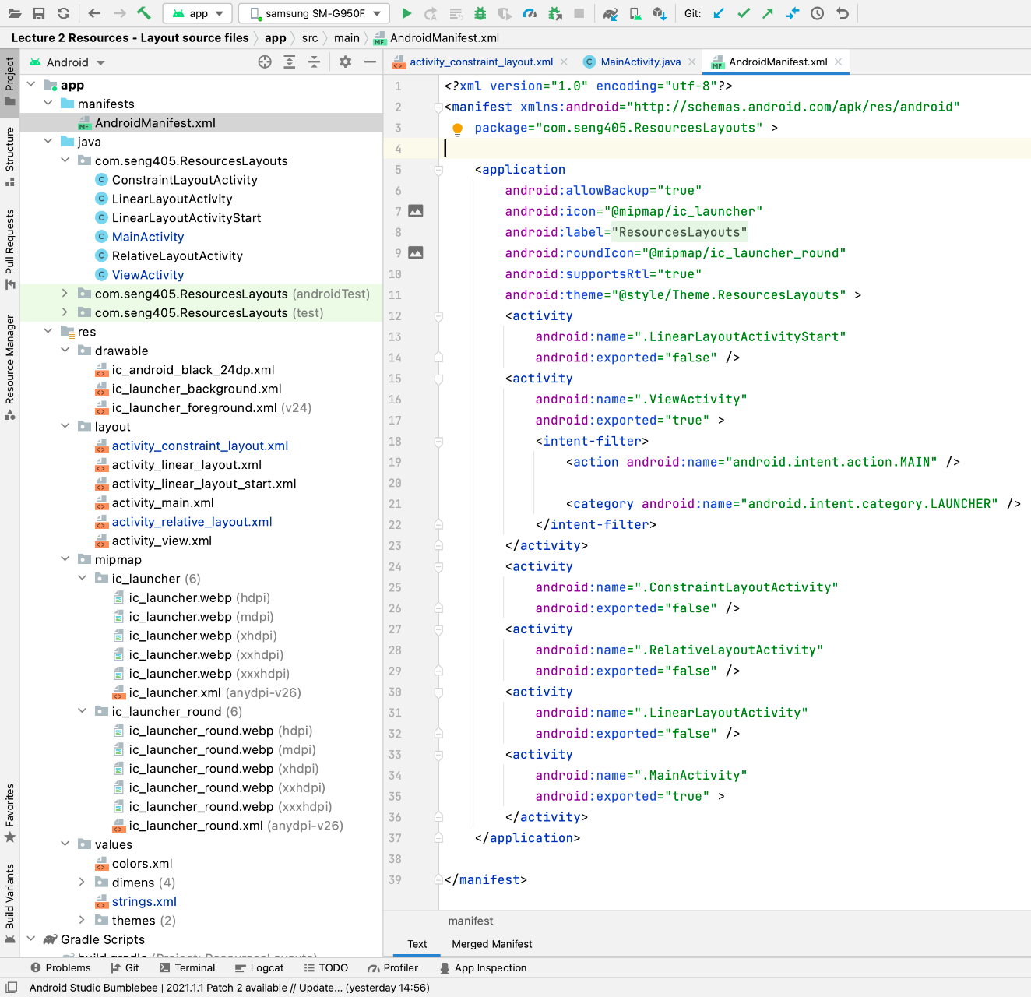
Multiple Activities
The whole point of interfacing with the Activity Lifecycle is to handle the fact that Android applications can have multiple activities and interact with multiple other applications.
We can easily create a New Activity through Android Studio by using File > New > Activity.

Slide 23
Intents
In Android, we don’t start new Activities by instantiating them (remember, we never instantiate Activities!). Instead, we send the operating system a message requesting that the Activity perform a particular action (i.e., start up and display on the screen).
These messages are called Intents, and are used to communicate between app components like Activities. The Intent system allows Activities to communicate, even though they don’t have references to each other (we can’t just call a method on that other Activity).
After having instantiated the Intent, we can use that message to start an Activity by calling the startActivity() method (inherited from Activity), and passing it the Intent.
This method will “send” the message to the operating system, which will deliver the Intent to the appropriate Activity, telling that Activity to start as soon as it receives the message.
And we can use the back button to go backwards!
Intents and Intent Filters | Android Developers

Slide 24
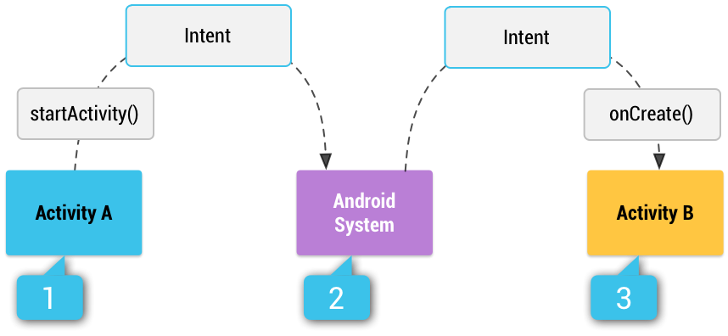
Intents
Intent intent = new Intent(MainActivity.this, SecondActivity.class);
startActivity(intent);

Slide 25
Intents Types
Explicit intents specify which application will satisfy the intent, by supplying either the target app's package name or a fully-qualified component class name. You'll typically use an explicit intent to start a component in your own app, because you know the class name of the activity or service you want to start. For example, you might start a new activity within your app in response to a user action, or start a service to download a file in the background.
Implicit intents do not name a specific component, but instead declare a general action to perform, which allows a component from another app to handle it. For example, if you want to show the user a location on a map, you can use an implicit intent to request that another capable app show a specified location on a map.

Slide 26
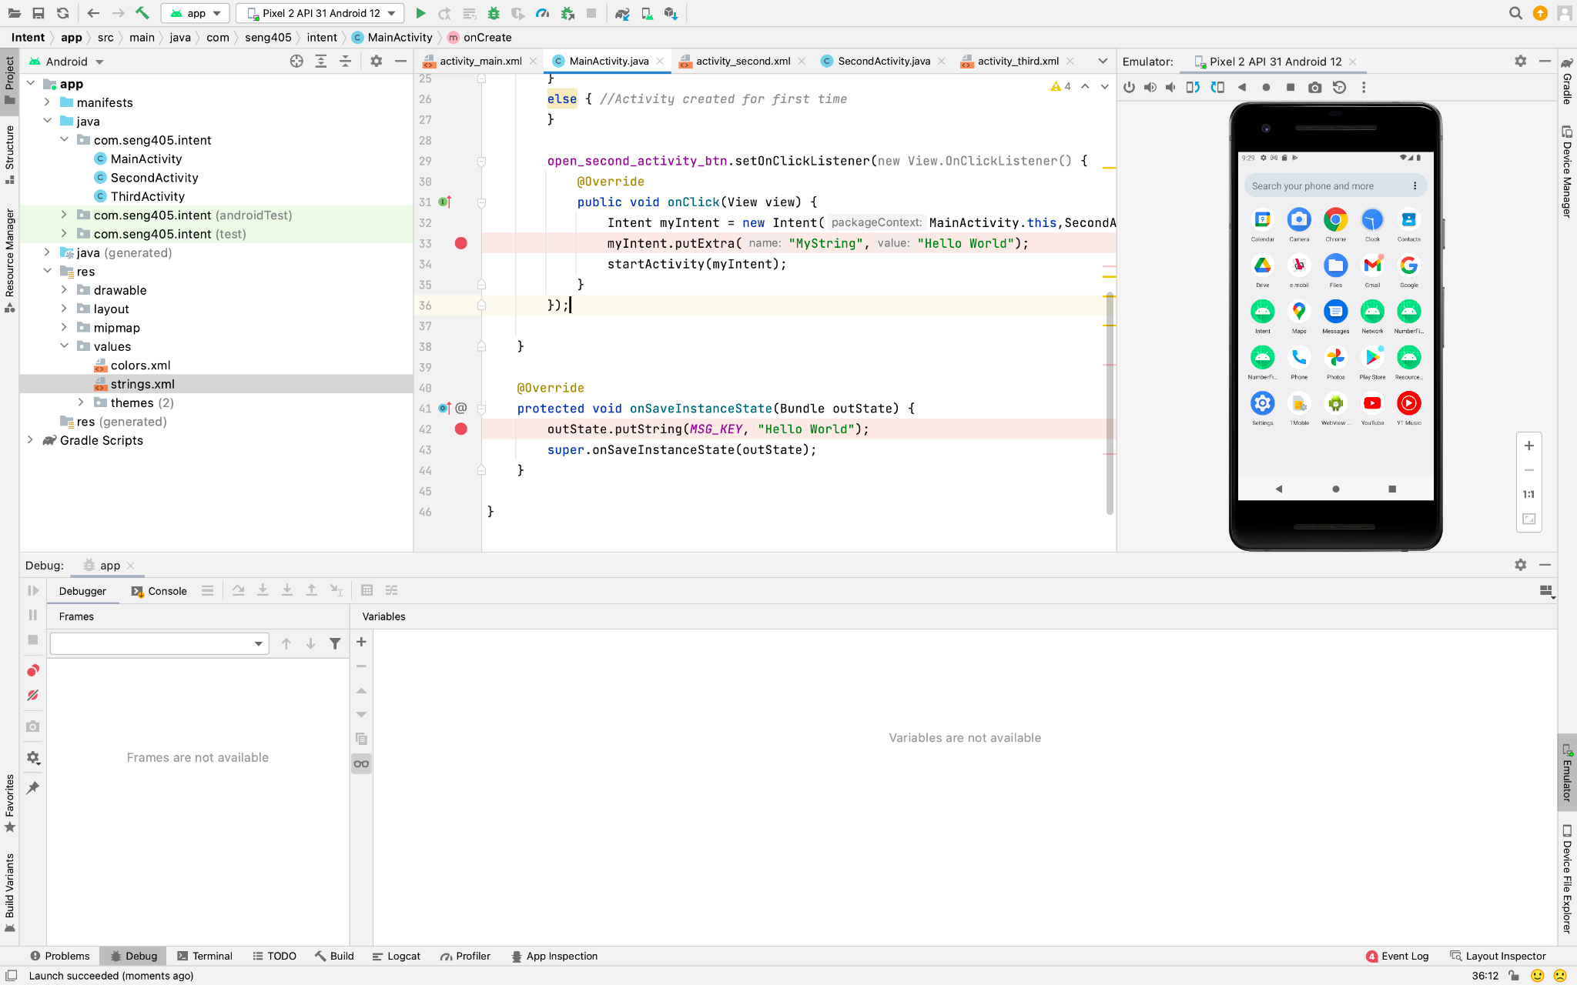
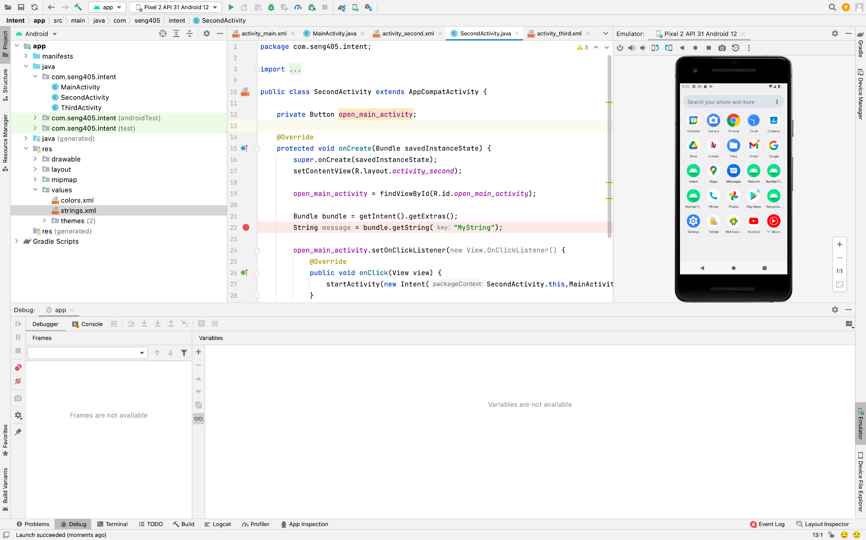
Bundle - Between Activities

Slide 27
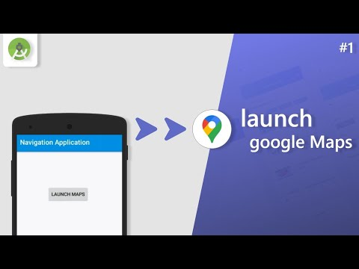

Slide 28
Back - Task
The device Home screen is the starting place for most tasks. When a user touches the icon for an app or shortcut in the app launcher (or on the Home screen), that app's task comes to the foreground. If no task exists for the app (the app has not been used recently), then a new task is created and the main activity for that app opens as the root activity in the stack.
When the current activity starts another, the new activity is pushed on the top of the stack and takes focus. The previous activity remains in the stack, but is stopped. When an activity stops, the system retains the current state of its user interface. When the user performs the back action, the current activity is popped from the top of the stack (the activity is destroyed) and the previous activity resumes (the previous state of its UI is restored). Activities in the stack are never rearranged, only pushed and popped from the stack—pushed onto the stack when started by the current activity and popped off when the user leaves it using the Back button or gesture. As such, the back stack operates as a last in, first out object structure.
Tasks and the back stack | Android Developers

Slide 29
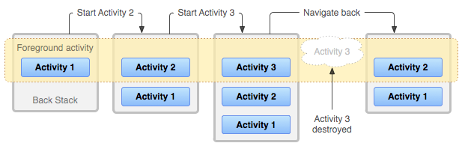
Back - Task
If the user continues to press or gesture Back, then each activity in the stack is popped off to reveal the previous one, until the user returns to the Home screen (or to whichever activity was running when the task began). When all activities are removed from the stack, the task no longer exists.
Root launcher activities are activities that declare an Intent filter with both ACTION_MAIN and CATEGORY_LAUNCHER. These activities are unique because they act as entry points into your app from the app launcher and are used to start a task.

Slide 30
Task
The way Android manages tasks and the back stack, —by placing all activities started in succession in the same task and in a last in, first out stack—works great for most apps and you shouldn't have to worry about how your activities are associated with tasks or how they exist in the back stack. However, you might decide that you want to interrupt the normal behavior. Perhaps you want an activity in your app to begin a new task when it is started (instead of being placed within the current task); or, when you start an activity, you want to bring forward an existing instance of it (instead of creating a new instance on top of the back stack); or, you want your back stack to be cleared of all activities except for the root activity when the user leaves the task.

